Slide 1
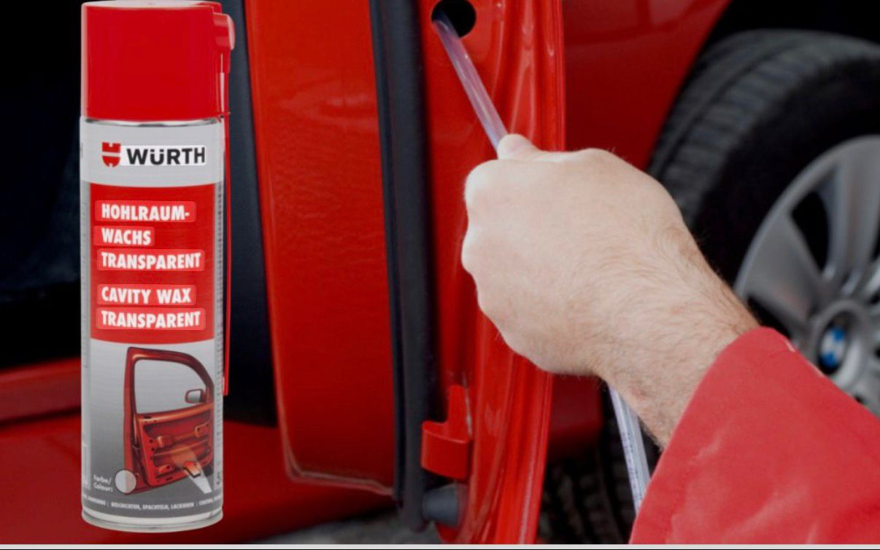

Wuerth Value Added Service – cavity wax

Slide 2
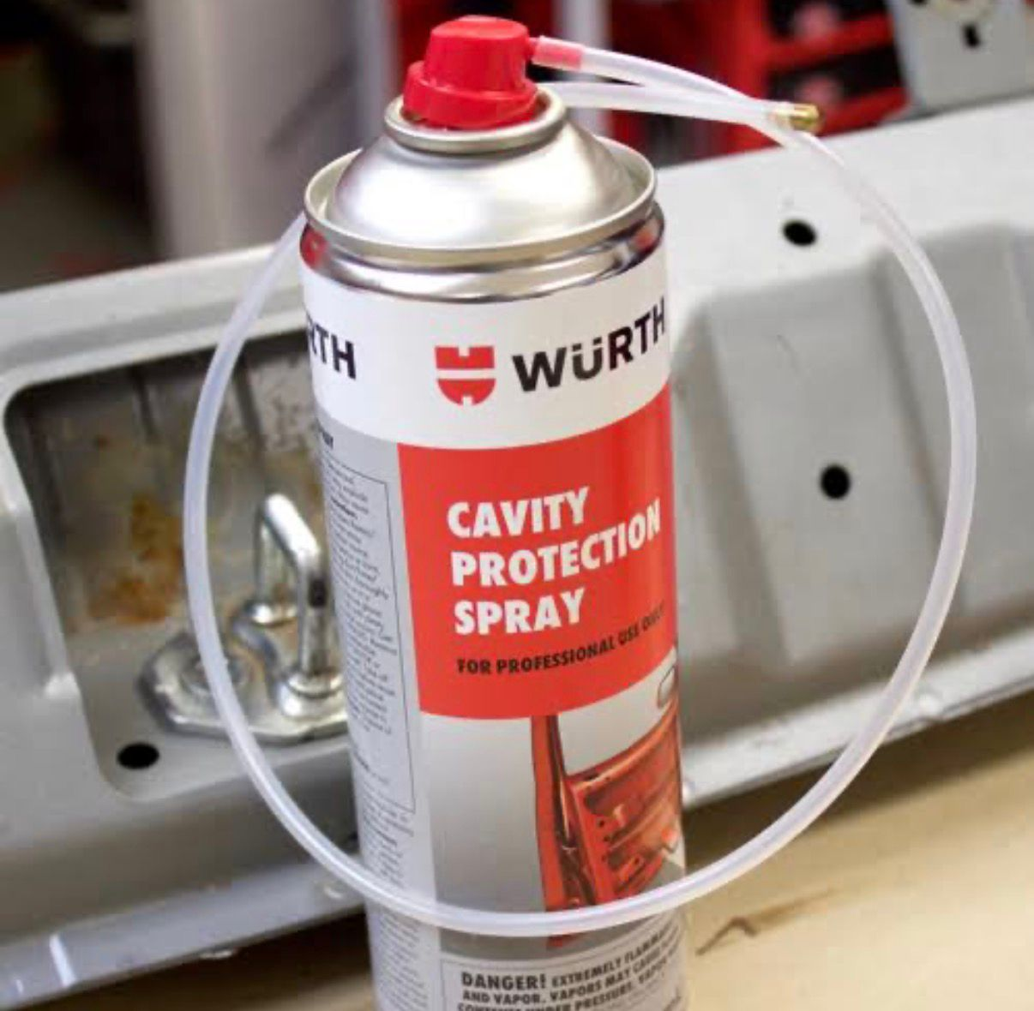
What is Cavity Wax Treatment
• Protective anti-rust treatment for hidden body parts
• Applied inside cavities like doors, pillars & panels
• Prevents corrosion from inside the vehicle body

Slide 3
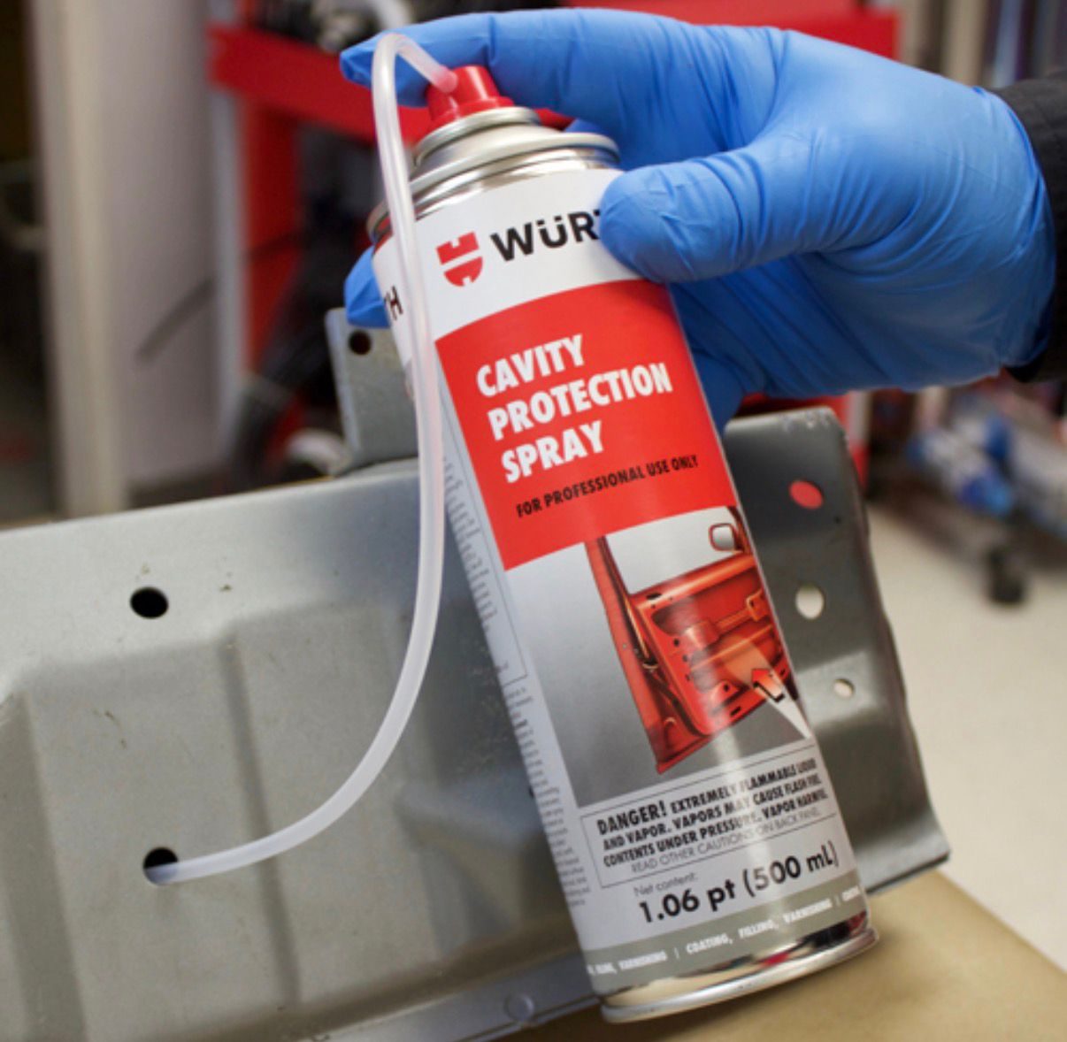
Cavity Wax Treatment Process
• Inspect vehicle cavities and rust areas
• Clean and dry internal panels
• Use special nozzle to spray cavity wax
• Wax spreads evenly inside hidden areas
• Excess wax wiped and final inspection done

Slide 4




Benefits of Cavity Wax Treatment
01
Ideal for coastal,rainy &
humid conditions
02
04
03

Slide 5

How Cavity Wax Treatment Improves Business
• High-value preventive service with good margin
• Easy upsell during new car & periodic service
• Combine with underbody or paint protection
• Builds customer trust & repeat business

Slide 6
Conclusion
• Cavity wax treatment is long-term rust protection
• Saves customers from costly body repairs
• Simple process with strong benefits
• Recommended for long vehicle life

Slide 7
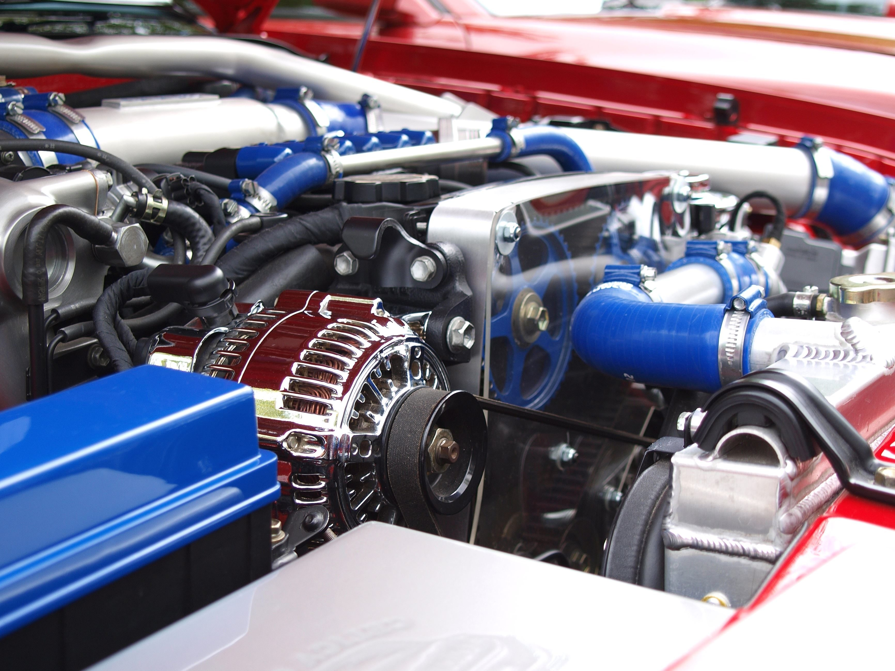
THANK YOU

